Slide 1
The Aryans Civilization
Indus civilization on the verge of collapse
about 1500 B.C.
settlement by a nomadic people-the Aryans

Slide 2
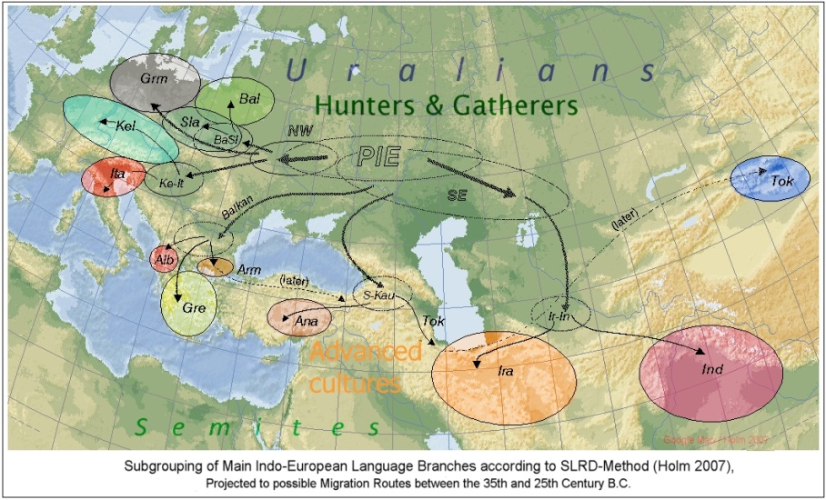
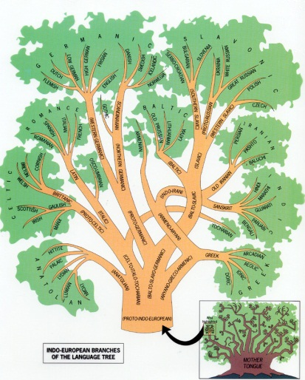
The Origins of the Indo-Aryans
The Indo-Aryans originated in Central Asia and invaded the subcontinent of India starting around 1500 B.C.
They are related to the Indo-European language group of nations and share similarities with modern Europeans and Iranians among other groups
The Sanskrit language that they introduced to India is closely related to modern English, Spanish, and German
They were a nomadic people who valued their oral traditions and maintained a warrior culture

Slide 3
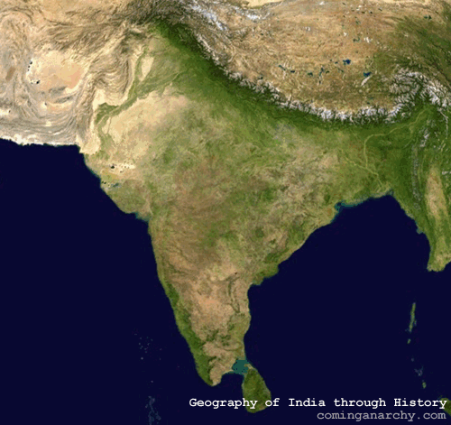
Aryan Invasion Routes
While isolated from the rest of Asia, the Indian subcontinent is accessible through major passes in the Hindu Kush range in what is now present-day Afghanistan
The Aryans would have likely made their way into the region through the Khyber Pass and, from there, across the rest of India
Hindu Kush
Indus River Valley
Himalayas
Ganges River Valley
Deccan Plateau

Slide 4
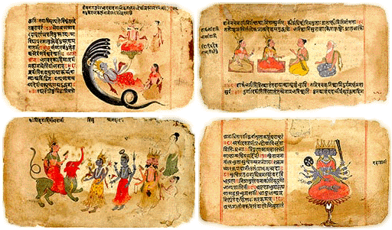
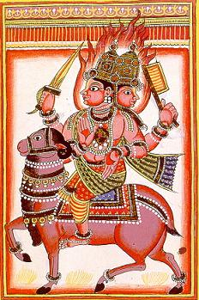
The Vedas
Indo-Aryan culture survived through oral traditions for hundreds of years until they were ultimately written down
The most important work is the Vedas, four collections of hymns, prayers, stories, and instructions for rituals
The Rig Veda is the most important of these works and provides some of the earliest evidence of the Aryan polytheistic belief system
Aryan gods tended to be heroic figures associated with sometimes destructive forces of nature, such as the fire god, Agni
Early manuscript of the Rig Veda (above); image of the fire god, Agni (below)

Slide 5
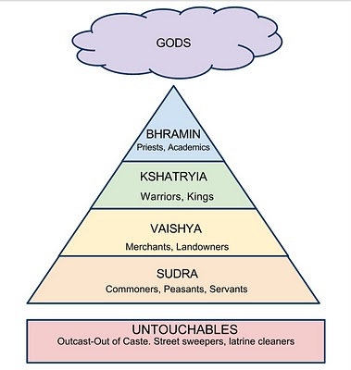
The Caste System
The Indo-Aryans introduced a caste system to India, based on a rigid social structure of four varnas, which were further subdivided into hundreds of jati
Aryans (“people of noble birth”) populated the top three castes of Brahmins (priests), Kshatriyas (warrior-princes), and Vaishyas (merchants), while conquered Dasas (darker-skinned peoples) made up the Shudras (laboring caste); race clearly played a role
“Untouchables” (harijans) did not even rate a caste and were associated with impure work (e.g., gravediggers, butchers, tanners, garbage collectors)
Racial diversity is still widely present in the subcontinent today

Slide 6
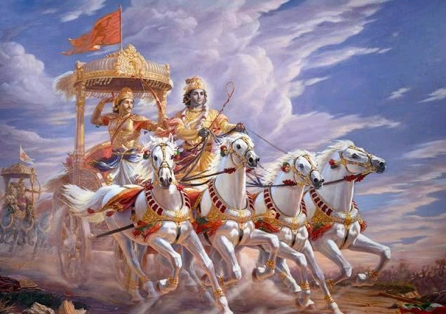
The Rise of Aryan Kingdoms
Thanks to the introduction of iron tools c. 1000 B.C., Aryans began to expand their settlements further east and south
Large Aryan kingdoms emerged, with Magadhada being the largest and most significant kingdom (later became the foundation of the Mauryan Empire by 320 B.C.)
The great epic of the Mahabharata, which recounts the conflict between two sets of cousins, is likely based on the Aryan wars of conquest as they moved south to dominate darker-skinned Dravidians

